Slide 1
HAP670 project
Krutika Deshmukh

Slide 2

what is hospital readmissions rate? and how it is measured?
A hospital readmission rate is the number of patients who must be hospitalized again within 30 days after their initial discharge. It’s a performance metric that tracks how many patients must return to the hospital due to complications from their previous visit and initial chief complaint.
why hospital readmissions ratio matters?
Hospital readmission rates are one of the top performance and quality measures for evaluating a hospital's delivery of care, and that’s why it’s essential for leadership to monitor them. Poor hospital readmission rates can lead to various negative impacts on a hospital, including decreased revenue.
Being discharged from the hospital can be dangerous. Adverse drug events are the most common postdischarge complication, with hospital-acquired infections and procedural complications also causing considerable morbidity.
Pathophysiologic syndrome of weakness and increased stress that may leave patients vulnerable to clinical adverse events such as falls and infections. As nearly 20% of Medicare patients are rehospitalised within 30 days of discharge, minimizing post-discharge adverse events has become a priority for the US health care system.
https://psnet.ahrq.gov/primer/readmissions-and-adverse-events-after-discharge.

Slide 3
BACKGROUND OF THE HOSPITAL
Miami Valley Hospital in Dayton, OH is rated high performing in 10 adult procedures and conditions. It is a general medical and surgical facility. It has the Dayton region's only Level I Trauma Center, a regional adult burn center, and a level 3 neonatal intensive care unit.
Outstanding clinical care is provided by Miami Valley Hospital's medical professionals, staff members, and volunteers. The Miami Valley Hospital Foundation generates money to improve the lives of patients and their families.​
Since its establishment in 1890, philanthropy has been integral to Miami Valley Hospital's prosperity. Every major construction project and medical advancement throughout the hospital's early years was made possible by contributions from the general people.​
Boost community support for innovative programmes and services that contribute to the development of healthy communities in order to improve the patient and family experience at Miami Valley Hospital.

Slide 4
ANALYSIS AND GOALS
ANALYSIS:
Health Data Analyst helps to identify patients at risk for avoidable readmissions by detecting readmission patterns among patients similar to the target population.
GOALS:
The main goal is to assess the hospital's performance by analysing the readmissions data that CMS has provided. The goals of this project are to improve patient care quality and maximise financial results.
prediction of readmission risks may help physicians and hospital management to develop early interventions, to identify and treat patients at high risk of readmissions (Hagland, 2011), and to enhance both care quality and financial outcomes
30 day readmission rule?
The policy penalizes hospitals for unrelated admissions that occur within 30 days of the original hospitalization. Readmissions unrelated to the initial reason for admission should be excluded from the readmission measures.

Slide 5
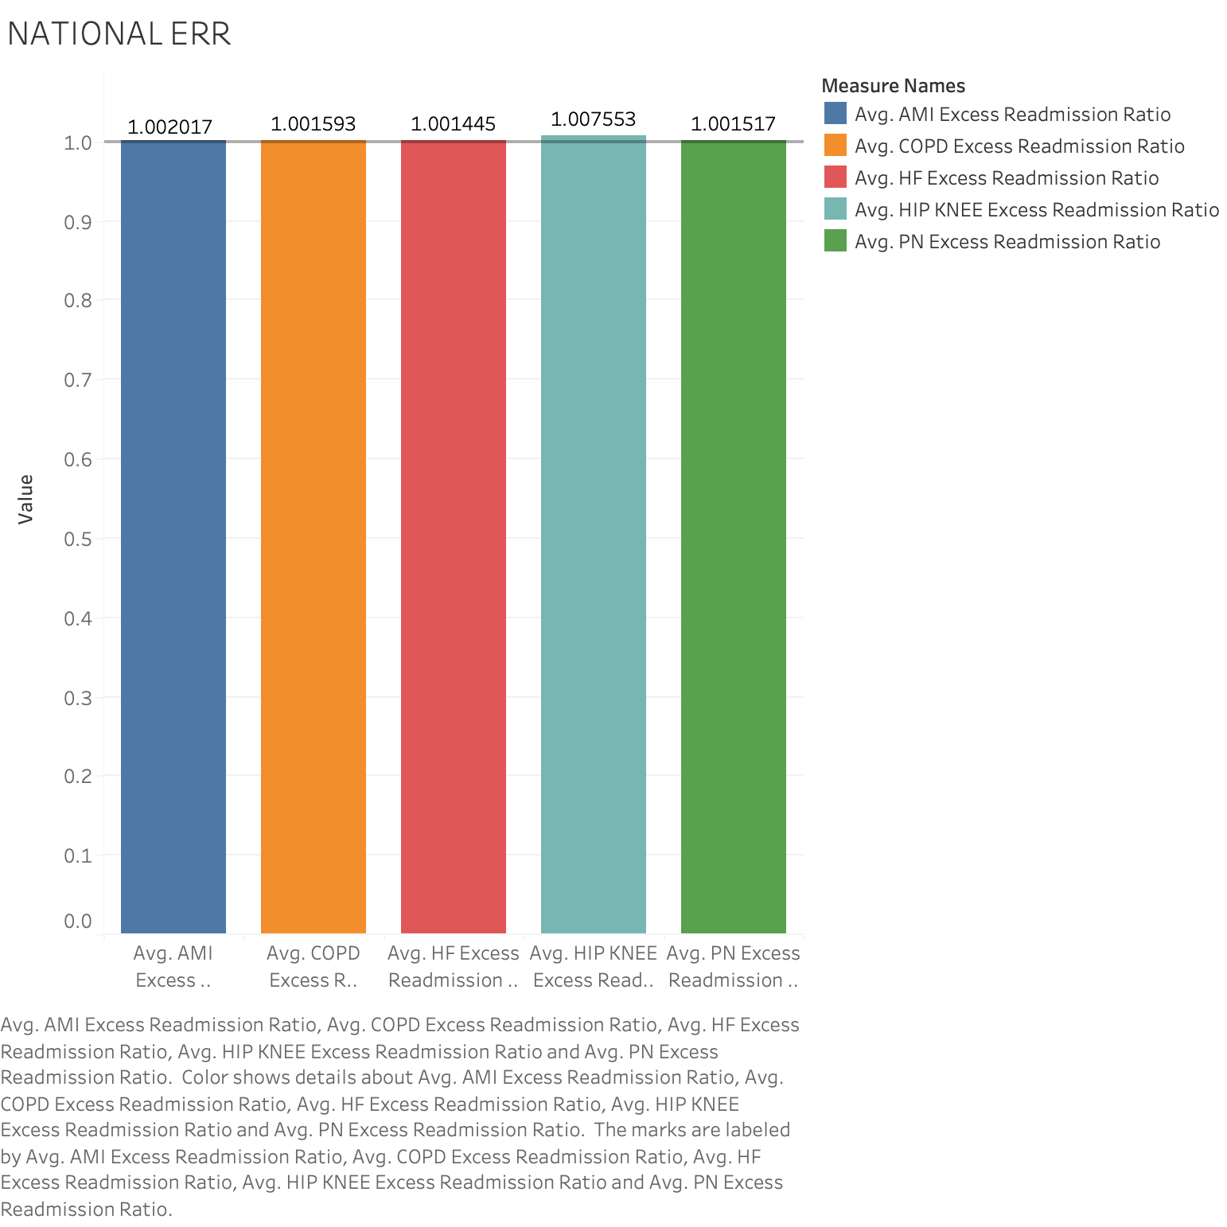
Excessive Readmission Rate National wise
This bar graph illustrates the Excessive Readmissions Rates (ERRs) on a national scale for various medical conditions.
The X-axis denotes different medical conditions, including Acute Myocardial Infarction, COPD, Heart Failure, HIP and Knee, and Pneumonia. Meanwhile, the Y-axis represents the ERR values.
All the colored bars in this graph have values exceeding one, indicating excessive readmissions for the specified medical conditions.

Slide 6
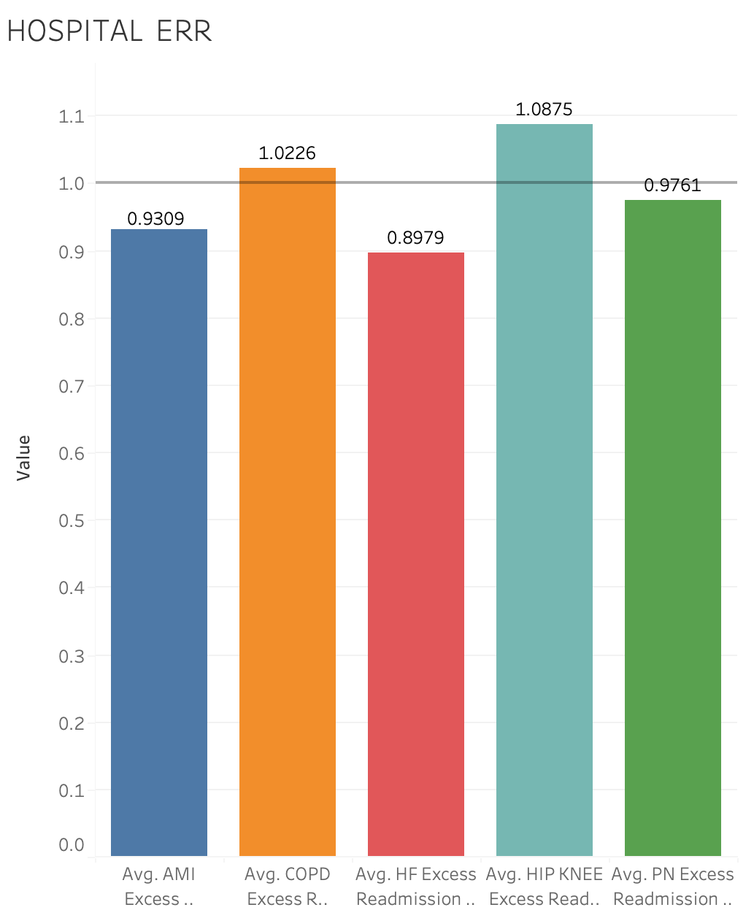
MIAMI HOSPITAL VALLEY EXCESS READMISSION RATIO
This bar chart illustrates the Excessive Readmissions Rate for Miami Valley Hospital.
On the X-axis, various medical conditions, including Acute Myocardial Infarction, COPD, Heart Failure, HIP and Knee, and Pneumonia, are represented.
The Y-axis displays different values for Readmissions Rate.
In Miami Valley Hospital, the Excessive Readmissions Rates for Hip/Knee and COPD are higher compared to the other three conditions, which have values below the threshold.
Therefore, the hospital should focus more on addressing Hip/Knee and COPD conditions to reduce the readmissions rates for these two specific medical conditions

Slide 7
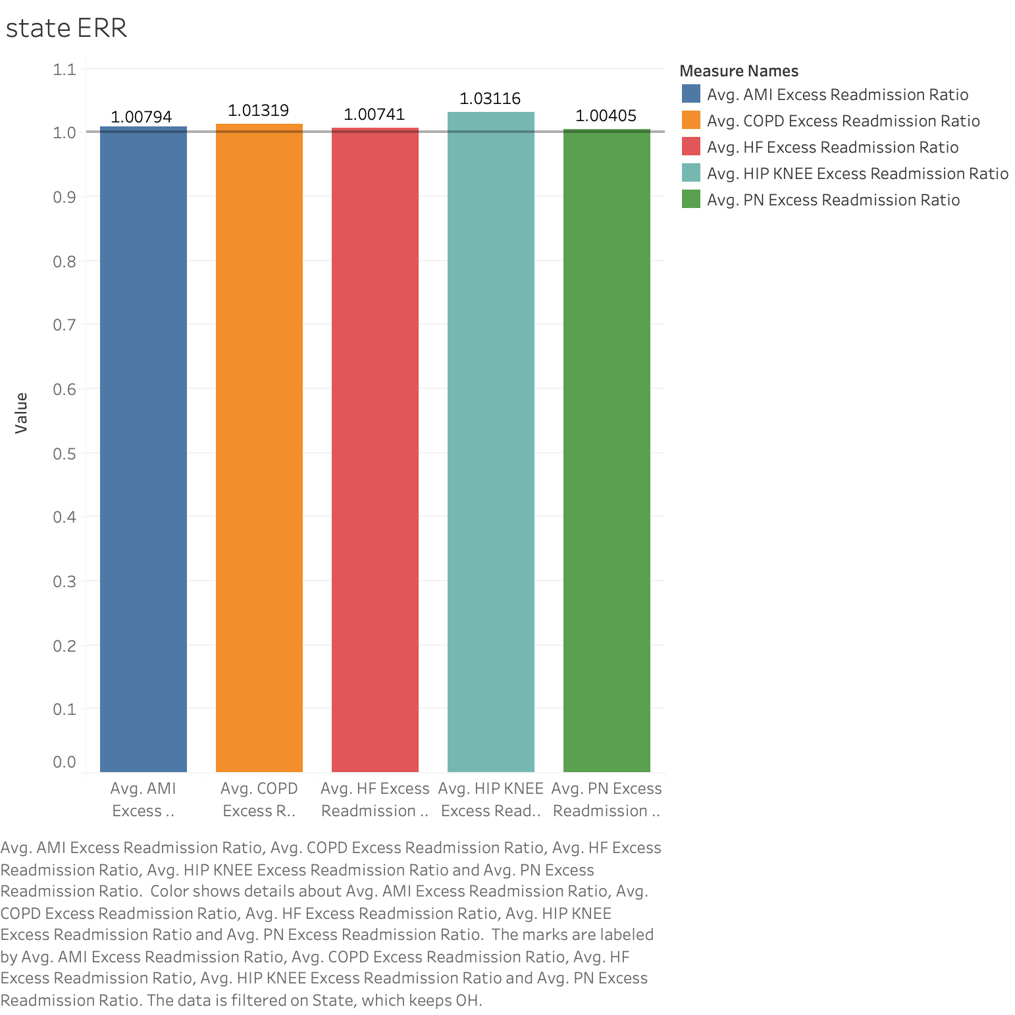
EXCESS READMISSION RATIO STATE WISE

Slide 8
EXCESSIVE READMISSION RATIO STATEWISEATIO STAT
The bar graph representing the excessive readmissions ratio for different medical conditions within Ohio State indicates that all conditions exhibit excessive readmission rates above one. Among these conditions, Hip and Knee have the highest excessive readmission ratio.

Slide 9
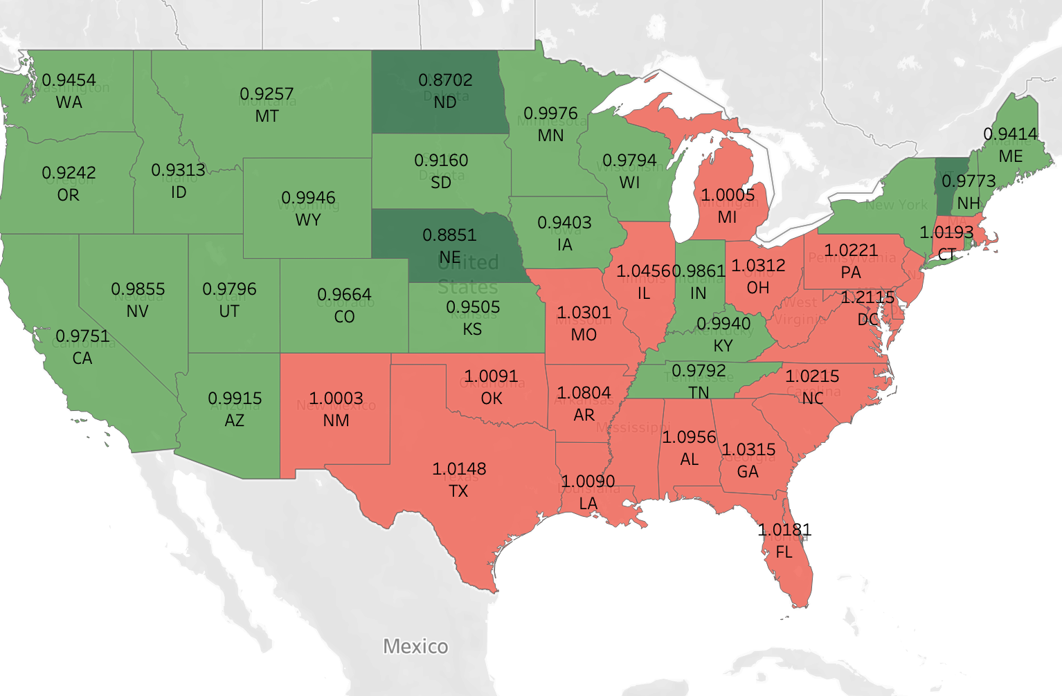
ERR FOR HIP/KNEE BY STATE
This map illustrates the excessive readmission ratio for Hip and Knee conditions across different states in the United States.
The color representation on the map visually displays the distribution of readmission ratios throughout the states.
The red color signifies an excessive readmission ratio, while the green color indicates lower readmission rates.
Examples of states with excessive readmission ratios include Florida, Texas, Ohio, Virginia, etc.
This visual representation provides an accessible and straightforward way to comprehend the variations in excessive readmission rates across different states

Slide 10
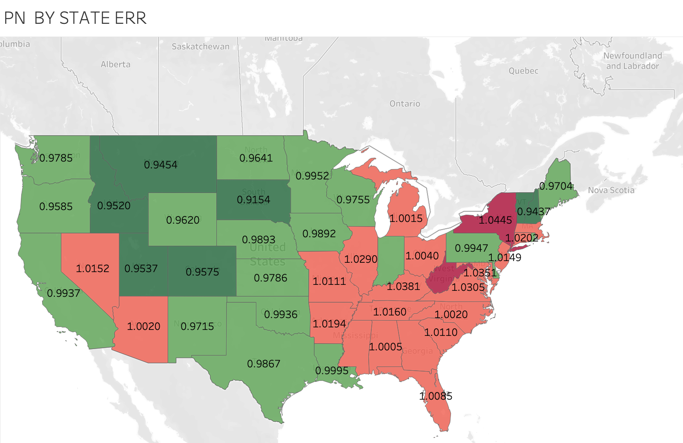
ERR FOR PNUEMONIA BY STATE
This map shows the high readmission rate for pneumonia in the different states of the United States.
There is an elevated readmission ratio shown by the darker colour.
The red-colored states on the map indicate higher readmission rates because their ERR values are larger than one. State-wise, the green states have readmission ratios that are lower since their numbers are fewer than one.
The disparities in the high readmission rates for pneumonia among the various states are clearly illustrated by this graphic portrayal.

Slide 11
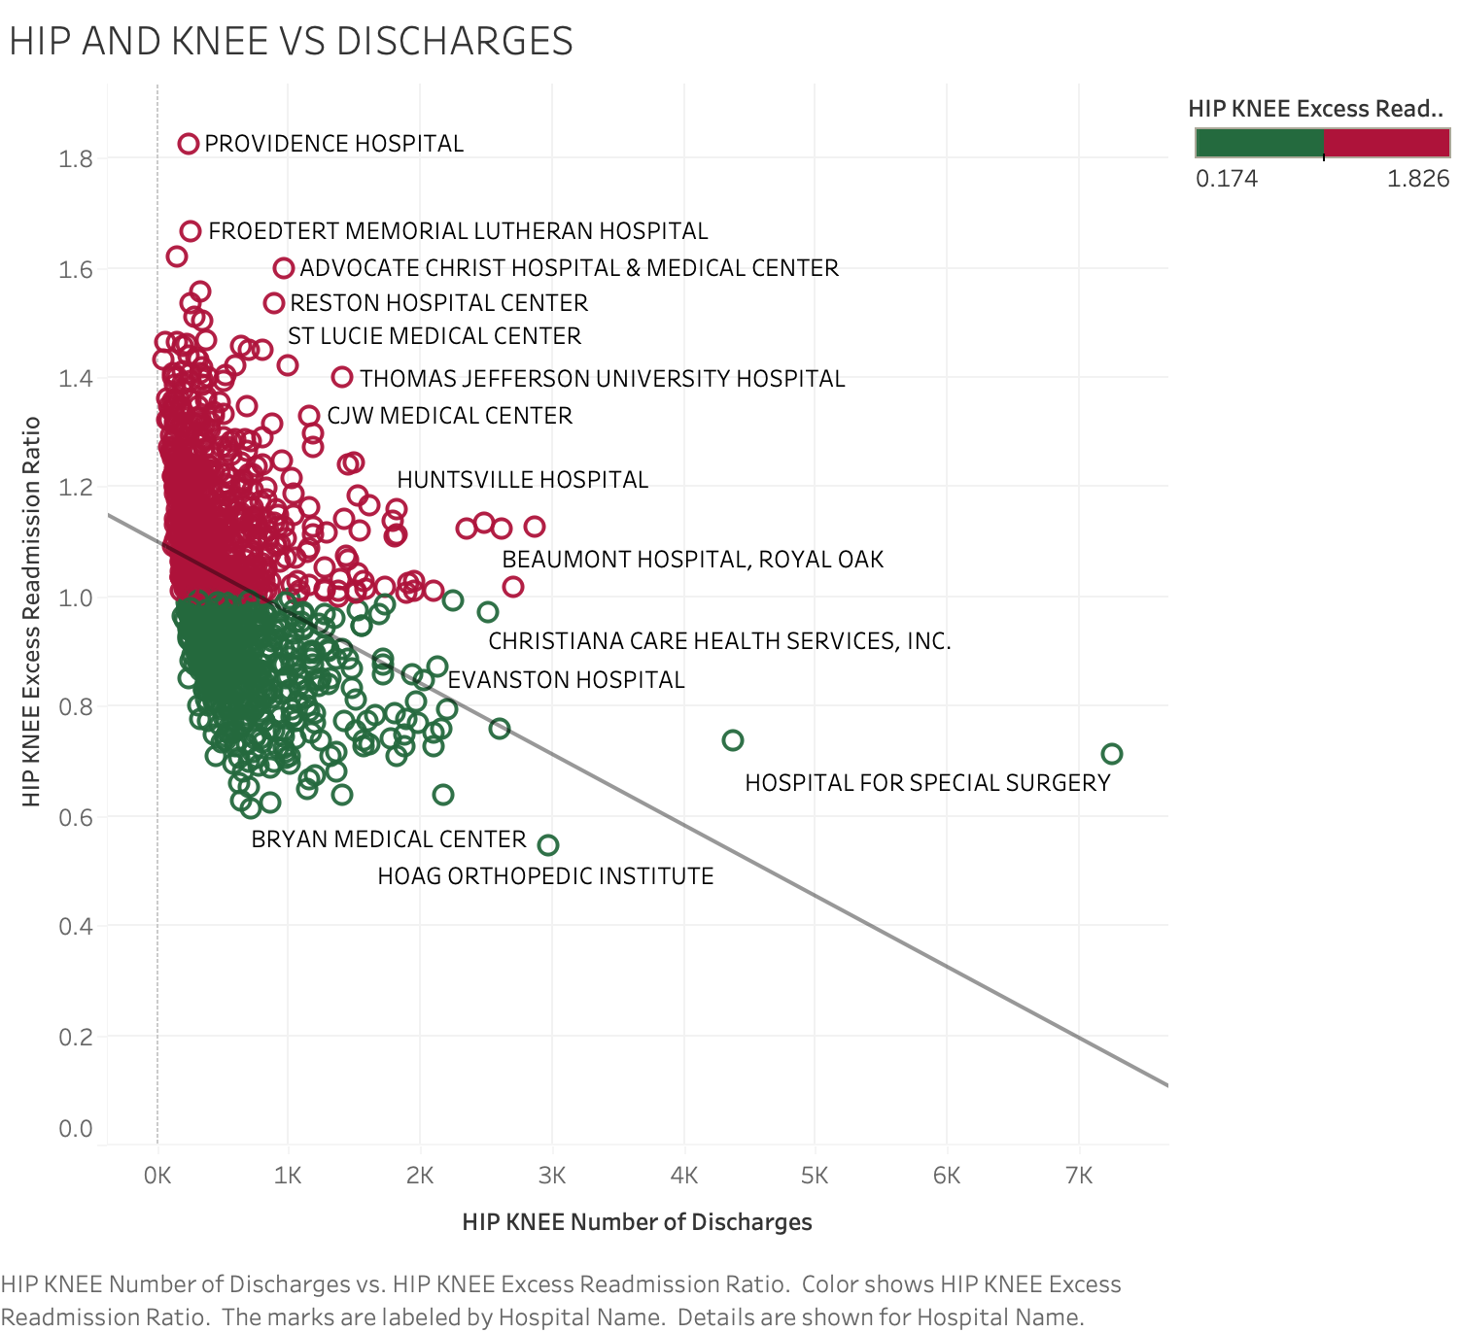
Hip/Knee ERRs vs Number of Discharges​
This scatter plot shows the correlation between the number of discharges from different hospitals and the high readmission rate. The Y-axis shows the excessive readmission ratio, and the X-axis shows the number of discharges for hip and knee issues. Every dot on the map denotes a different hospital.
Understanding the correlation between the variables represented on the X- and Y-axes is made easier with the help of the trend line. In this case, a clear trend can be seen: the excessive readmission ratio tends to decline as the number of discharges declines.
The red-colored hospitals have readmission rates that are habitually higher than 1. Hospitals highlighted in green, on the other hand, regularly have readmission ratios below 1. The ability to clearly identify hospitals with higher or lower rates of excessive readmission is improved by this color-coded distinction.

Slide 12
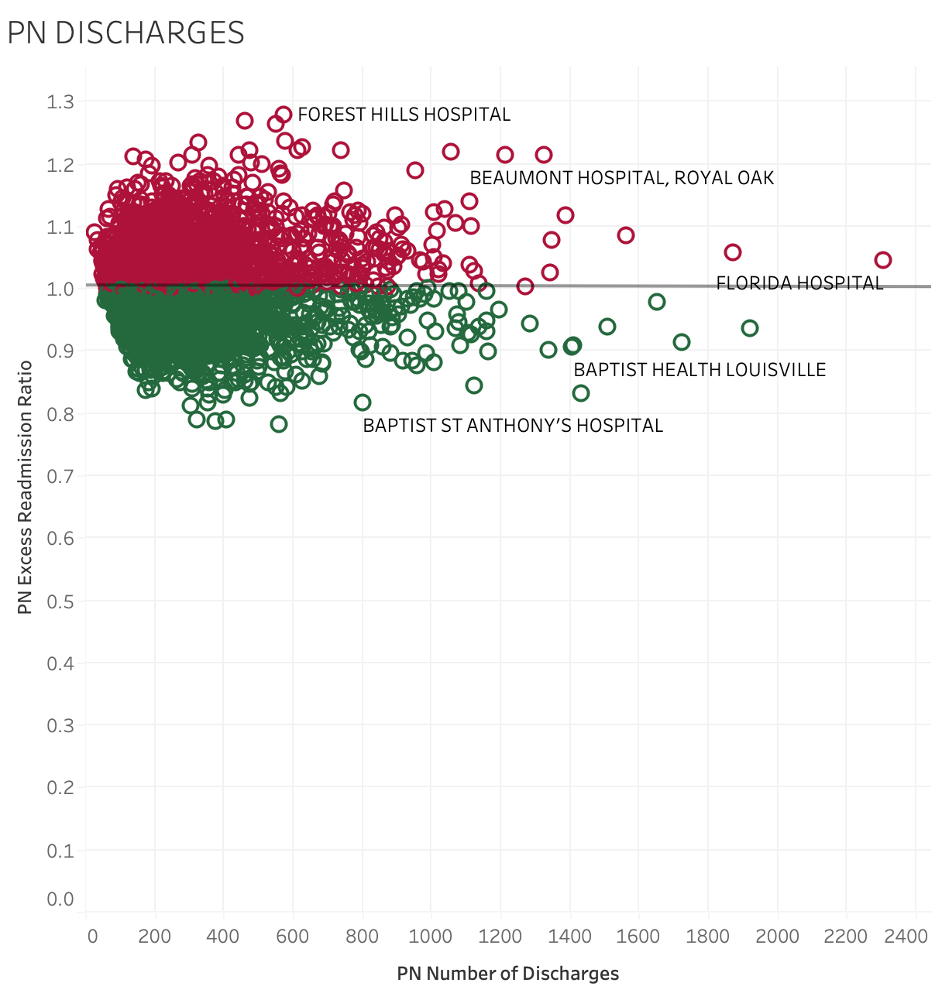
PNUEMONIA ERR VS NUMBER OF DISCHARGES
The scatter plot illustrates the correlation between the frequency of pneumonia discharges from different hospitals and the Excessive Readmission Ratio. For pneumonia, a linear trend line is clearly visible, indicating that for every unit change in the independent variable (on the x-axis), there is a consistent proportional change in the dependent variable (on the y-axis).
A distinct hospital is represented by each dot on the plot. Green dots represent decreased readmission ratios below one, and red dots represent excessive readmission rates above one.
The number of discharges is shown on the X-axis, and the values for the excessive readmission ratio are shown on the Y-axis. This graphic illustrates the relationship between the quantity of discharges and the related high readmission rates for pneumonia in various hospitals.

Slide 13
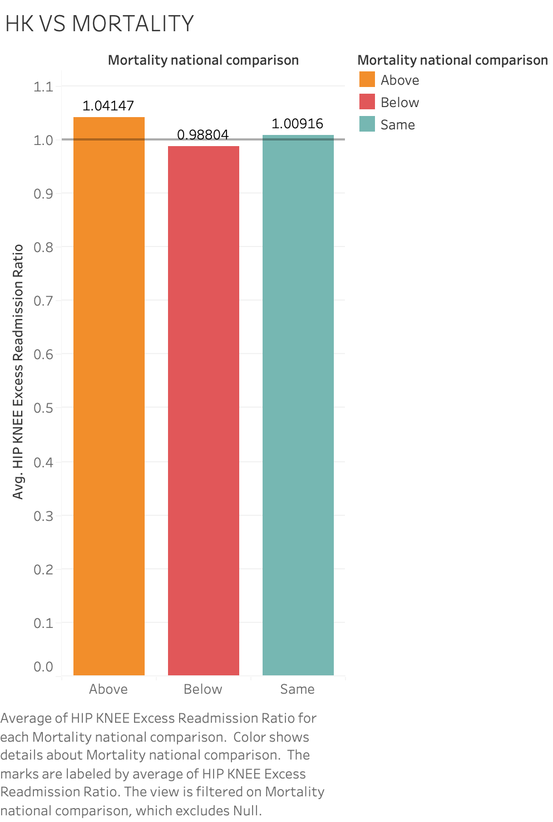
Hip and Knee vs mortatilty rates
This bar graph compares hospitals across the country according to their performance in terms of mortality rates and hip/knee excess readmission ratios (ERRs). Hospitals are ranked in relation to the national average as "Above," "Below," or "Same."​
A range of 1.0 is assigned to a constant line.
X axis: National Comparison of Mortality.​
Avg HIP/knee excess readmission rates are shown on the Y axis.
This bar chart makes it easier to quickly evaluate the connection between hospital mortality rates nationwide and hip/knee ERRs

Slide 14
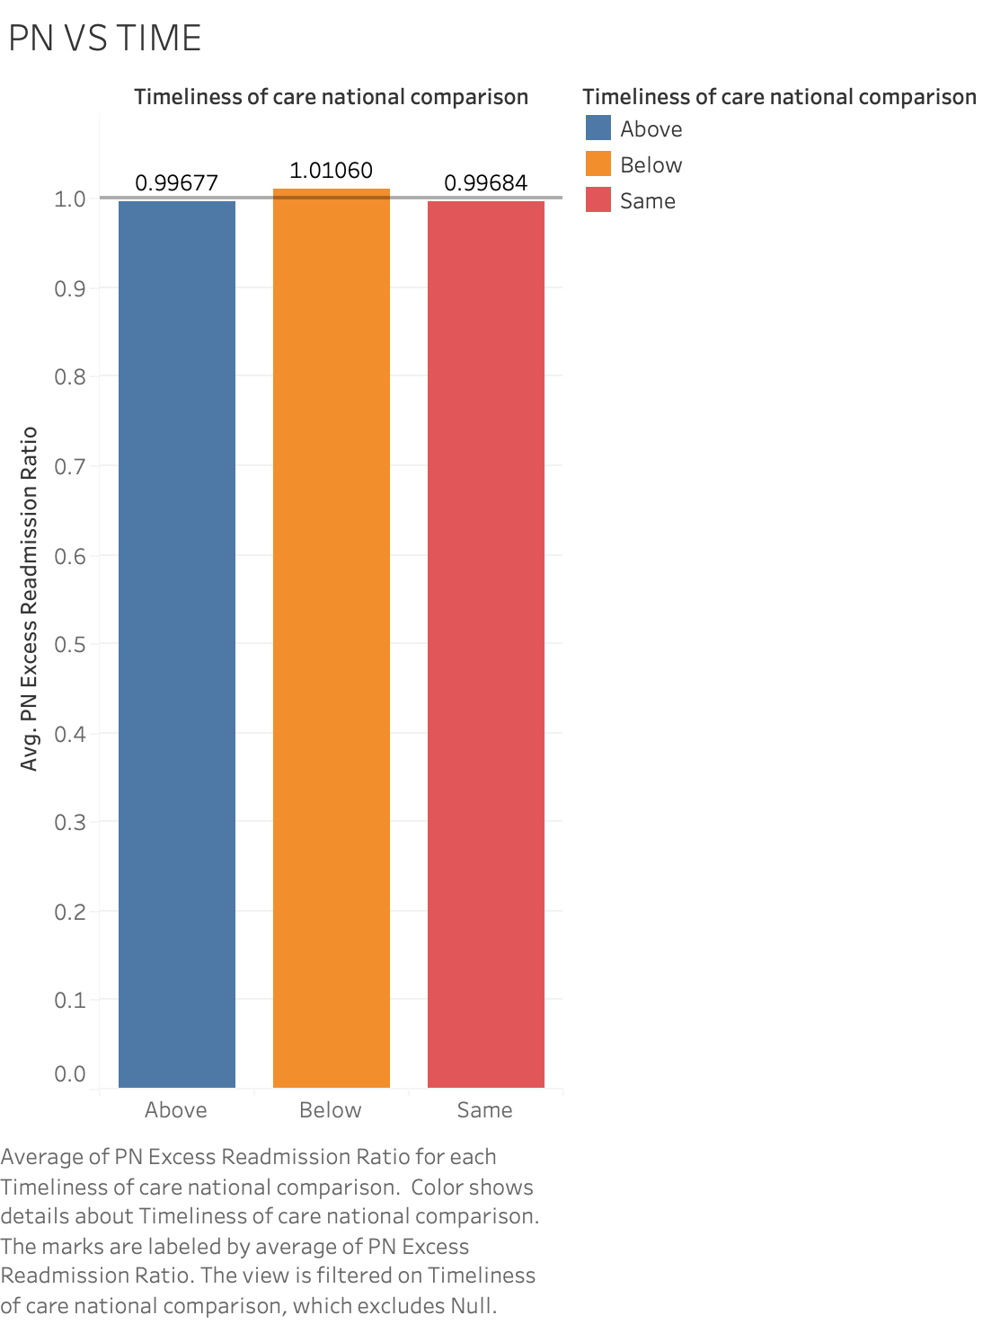
PNEUMONIA VS TIMELINESS OF CARE NATIONAL COMPARISION
This bar chart compares hospitals nationwide, illustrating the correlation between Excess Readmission Ratios (ERRs) related to Pneumonia conditions and the Timeliness of Treatment and Care. The hospitals are classified into three categories: 'Above National Average,' 'Below National Average,' and 'Same as National Average' based on their Timeliness performance.
Above National Average:
Signifies hospitals with ERRs surpassing the national average, suggesting potentially higher readmission rates for PNEUMONIA condition.
Below National Average:
Represents hospitals with ERRs lower than the national average, indicating superior performance in managing readmissions for PNEUMONIA conditions.
Same as National Average:
Encompasses hospitals with ERRs aligning closely with the national average.
This presentation provides a clear visual representation of how different hospitals fare in terms of ERRs for PNEMONIA conditions concerning the timeliness of treatment and care, offering insights into potential variations in readmission rates.

Slide 15
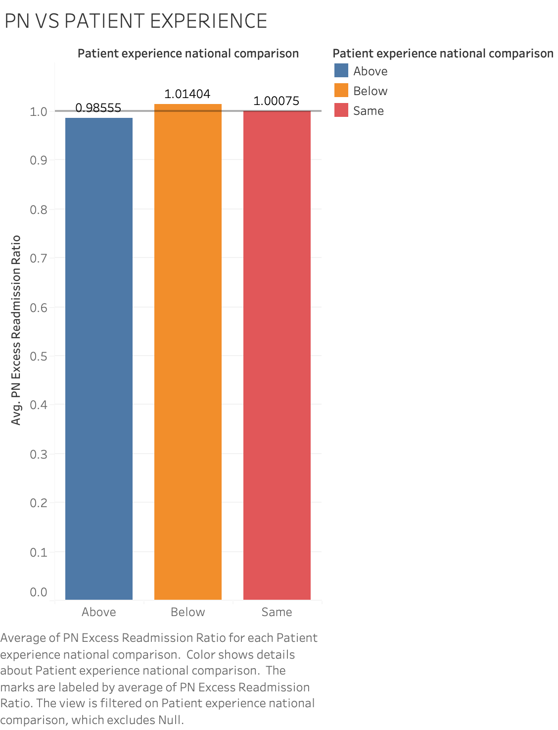
PNEUMONIA VS PATIENT EXPERIENCE NATIONAL COMAPRISION
This bar graph shows the performance of hospitals across the country in terms of patient experience and excess readmission ratios (ERRs) for pneumonia. Based on patient experience, hospitals are ranked as "Above," "Below," or "Same as National Average."
Above the national average:
elevated readmission rates due to pneumonia, possibly due to high ERRs.
Lower than the national average:
Better treatment of pneumonia readmissions is indicated by low ERRs.
Comparable to the national average:
ERRs are quite similar to the national average.
The graph which is improved by a continuous line, gives a clear picture of hospital performance in terms of readmission rates in relation to patient experience quality and rapidly evaluates the relationship between pneumonia ERRs and patient experience nationally.

Slide 16
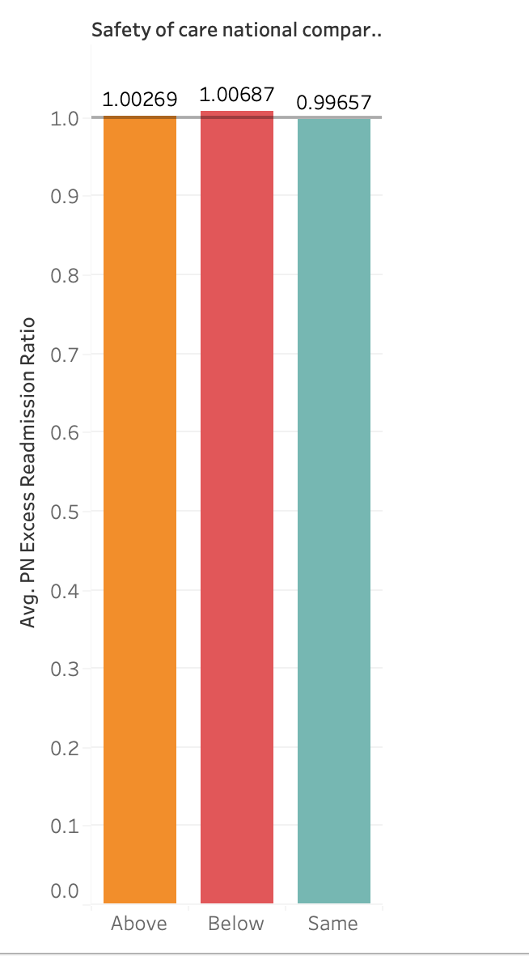
PNEUMONIA VS SAFETY OF CARE NATIONAL COMAPRISION
This bar graph illustrates a countrywide evaluation of hospitals and highlights the correlation between the Safety metric and Excess Readmission Ratios (ERRs) for pneumonia. In terms of safety, hospitals are categorised as 'Above National Average,' 'Below National Average,' or 'Same as National Average' on the X-axis, and the pneumonia ERR bars align with the Y-axis.
Hospital safety performance is represented by each category on the X-axis, with a constant line representing the national average. This visual aid provides a quick summary of hospital performance in respect to safety criteria and simplifies the analysis of the relationship between pneumonia ERRs and the Safety measure on a nationwide level.

Slide 17
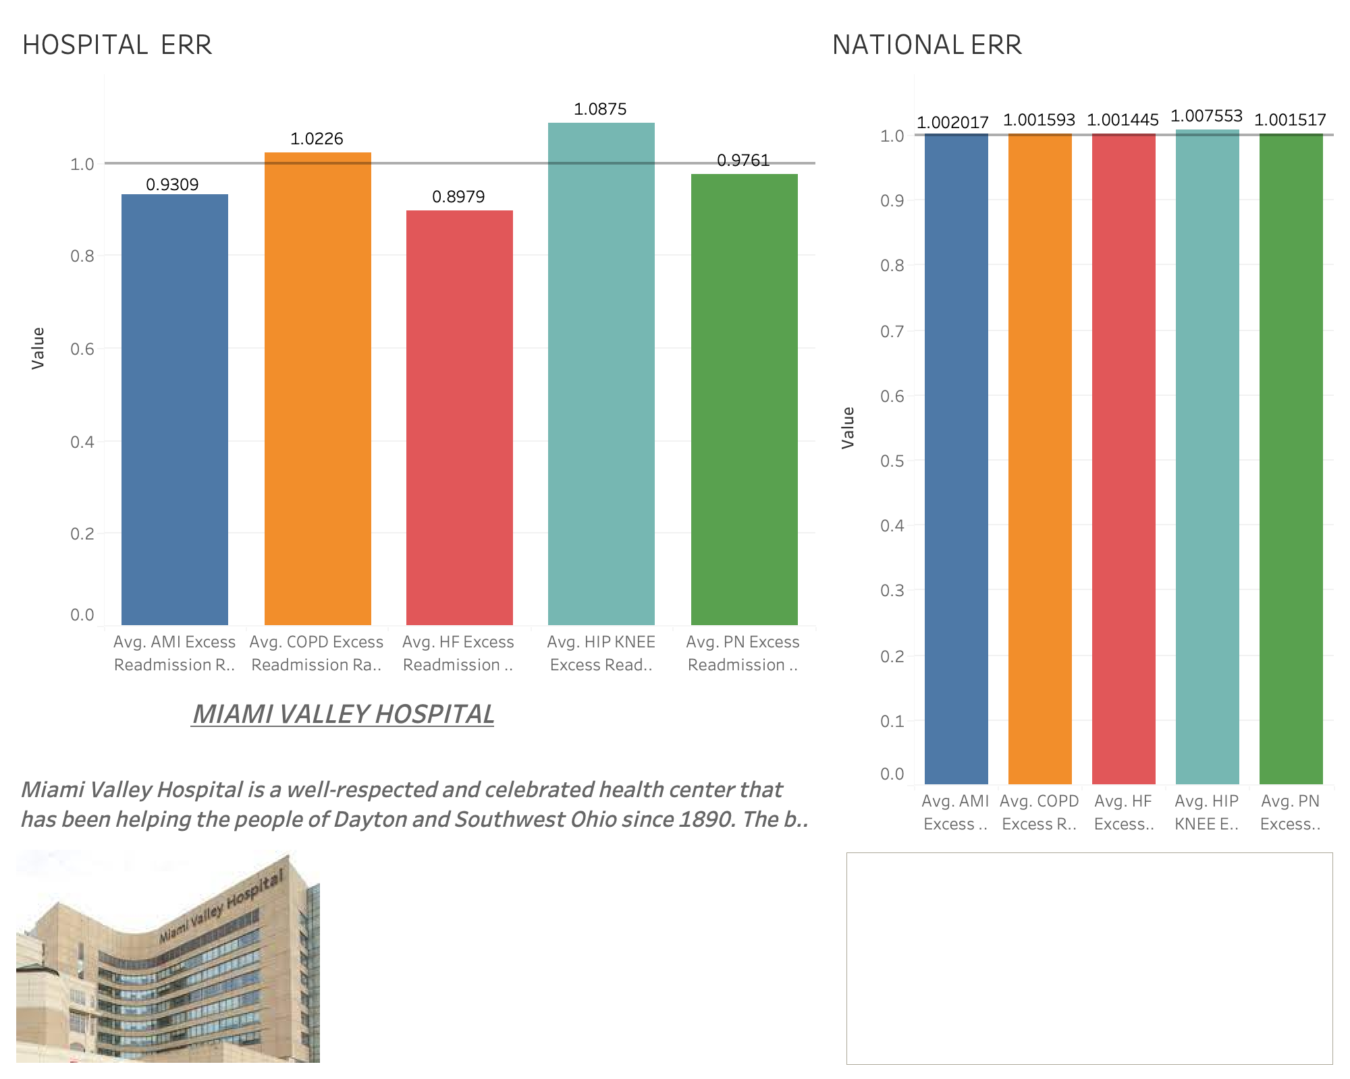
DASHBOARD

Slide 18
An overview of excess readmission ratios (ERRs) for serious medical illnesses is given on the dashboard slide . It presents data from both a national and local viewpoint, with a particular emphasis on Miami Valley Hospital.​
A bar chart illustrating the comparison of ERRs across national boundaries is displayed on the left side of the presentation. Each bar represents a particular average readmission rate (ARR) for a medical condition, giving a rapid visual assessment of the country's readmission performance.​
A bar chart illustrating Miami Valley Hospital's readmissions management performance is displayed on the right side of the presentation. A direct comparison between the hospital and the national benchmarks is made possible by the bar chart, which displays the ERRs for the same medical problems.

Slide 19
Comparing nationally (bar chart):
Different medical conditions have different readmission rates; the hip/knee disease has the highest percentage of excessive readmissions.
Hospital Rates in the Miami Valley (Bar Chart):
found inadequacies in COPD and hip/knee readmission rates in relation to other conditions.
Rates in Ohio State (Bar Graph):
Readmission rates are excessive for all conditions combined, with the highest ratio seen in Hip/Knee.
Hip/Knee Readmissions by US State (Map):
Map identifies states with high hip/knee readmissions, including Florida, Texas, Ohio, and Virginia.
Pneumonia Readmissions by State in the US (Map):
shows high readmissions of pneumonia and provides information on regional differences.

Slide 20
Hospital-Level Scatter Plot Relationship:
Lower readmission ratios are suggested by a linear trend when the number of discharges declines.
Hip and knee readmissions at the hospital level (scatter plot):
There is a definite correlation between hip/knee discharges and readmissions; hospitals with high rates are indicated by color-coding.
Pneumonia Readmissions at the Hospital Level (Scatter plot)
shows a linear trend, with colour differences for different ratios, between pneumonia discharges and readmissions.
Readmission Ratio at the Hospital Level and Discharges (Scatter Plot):
A thorough analysis of the connection between hospital discharges for pneumonia and readmission rates.
The overall findings indicate variations in readmission rates across conditions and geographical locations. Specific deficiencies in Hip/Knee and Pneumonia readmissions were observed, suggesting a need for targeted interventions at both the national and hospital levels. Resolving these issues may result in better patient outcomes and lower than expected readmission rates, which would be consistent with the hospital's objectives for more effective and high-quality healthcare.

Slide 21
Reducing Readmission Rates for Hospitals:
1)As a means to help reverse the effects of avoidable readmissions and their causes, the requirements for HRRP should be instituted(Hospita Readmission Reduction Program)
What is the Hospital Readmissions Reduction Program?
HRRP is a Medicare value-based purchasing program that, for example, encourages hospitals to improve communication and care coordination to better engage patients and caregivers in discharge plans and, in turn, reduce avoidable readmissions.
2) Utilise Analytics to Find Areas for Improvement:
It's critical to first recognise the causes of hospital readmission rates and foresee potential difficulties in order to lower them. Readmission rate patterns and trends can be found with the use of data analytics, highlighting areas that require improvement.
Regularly examining hospital readmission rates helps hospitals pinpoint the underlying causes of problems, monitor their advancement, and make necessary adjustments.

Slide 22
3) Identify At-Risk Patients Early:
Evaluating patients' social needs during hospitalisation and discharge is a critical first step in lowering readmission rates. Finding patients who have unfulfilled social requirements can assist guarantee that they get the post-discharge treatments they require (such medication reconciliation post-discharge, or MRP).
4) Strengthening the Discharge Process:
Ensure that all members of the team—physicians, nurses, social workers, the patient, and any family members or caregivers—are included in a clear care plan.
Timely follow-up also provides a way to become aware of potential complications and correct them early on.
Follow-up within seven days significantly reduces readmission risk for HRRP priority conditions. CMS assesses unplanned readmissions within 30 days for six primary conditions: pneumonia, heart failure, coronary artery bypass graft (CABG), total hip or knee arthroplasty (THA/TKA), acute myocardial infarction (AMI), and chronic obstructive pulmonary disease (COPD).

Slide 23
IMPROVING MEDICATION MANAGEMENT
Simplifying the medication reconciliation process at the institution is one of the best strategies to lower the readmission rate to the hospital.
Comparing a patient's current and past prescriptions is known as medication reconciliation.
This helps guarantee that the patient is taking the right drugs and that there are no dosage mistakes, drug interactions, or duplications.
https://blog.cureatr.com/reducing-readmission-rates-for-hospitals-5-essential-strategies

